Slide 1
M-Task Framework

Slide 2
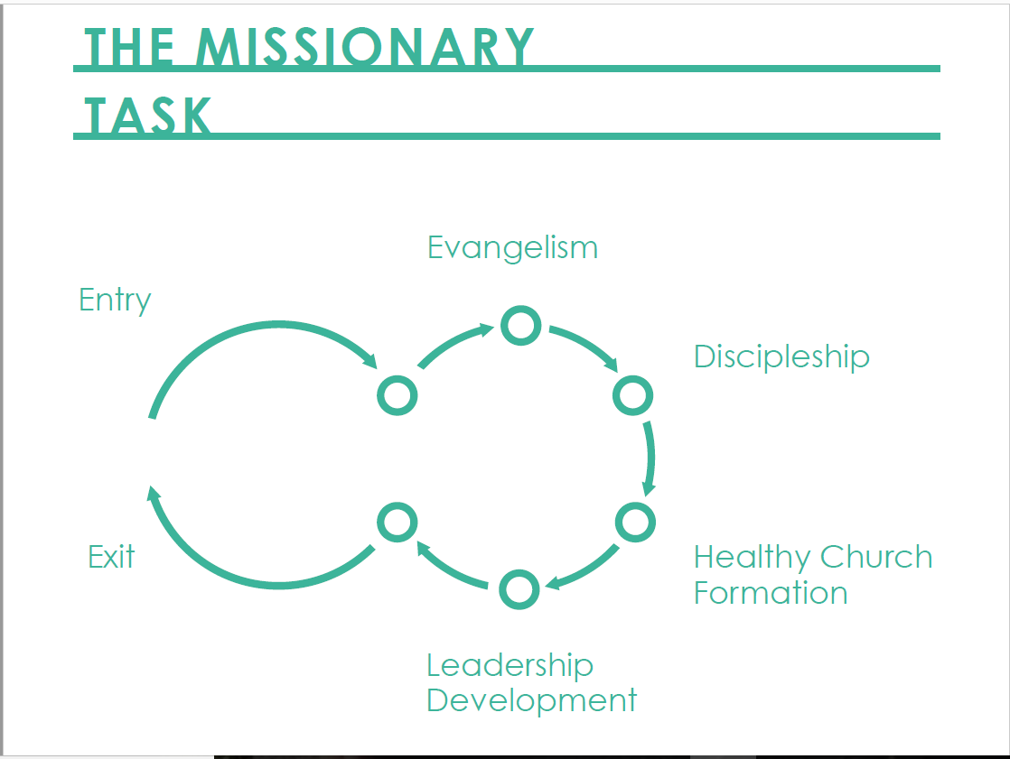

Slide 3






Habakkuk 2:14
Matthew 28:18-20
John 3:16
Revelation 7:9

Slide 4


Habakkuk 2:14
Matthew 28:18-20
John 3:16
Revelation 7:9

Slide 5






Habakkuk 2:14
Matthew 28:18-20
John 3:16
Everywhere to Everywhere
1.
2.
Revelation 7:9
5.
6. E2P
Multiplication to Everywhere
4.
3.

Slide 6
1. Entry

Slide 7
1. Entry
Saved
Lost
Cast-Vision
Bridge to Gospel

Slide 8
1. Entry
2. Biblical Evangelism

Slide 9
2. Biblical Evangelism
Cast-Vision
Testimony
Gospel Tool
Yellow-Light Strategy

Slide 10
1. Entry
2. Biblical Evangelism
3. Biblical Discipleship

Slide 11
3. Biblical Discipleship
Short-Term Discipleship
Long-Term Discipleship
3 / 3 Process

Slide 12
1. Entry
2. Biblical Evangelism
4. Healthy Church Formation
3. Biblical Discipleship

Slide 13











4. Healthy Church Formation

Slide 14
1. Entry
2. Biblical Evangelism
5.
Leadership Development
&
Theological Education
4. Healthy Church Formation
3. Biblical Discipleship

Slide 15


1. Entry
2. Biblical Evangelism
5.
Leadership Development
&
Theological Education
6. Exit to
Partnership
4. Healthy Church Formation
3. Biblical Discipleship

Slide 16
Habakkuk 2:14
Matthew 28:18-20
John 3:16
E2E
1.
2.
Revelation 7:9
5.
6. E2P
M2E
4.
3.

